Slide 1







WELCOME TO THE OUR PRESENTATION
PFP191 - AI18C
MOVIES SEARCH ENGINE
GROUP VANDV

Slide 2
GROUP MEMBERS
NGUYEN QUOC NHUT
TRAN HUY DUONG
TRAN XUAN BAO VIET
VO MAI KHA VI
NGUYEN THI TU ANH

Slide 3

CONTENTS
02
03
04
05
01
Project goals and significance
Research and Project requirements
Research and data processing
Design function
Division of tasks
08
07
06
FEEDBACK
Q&A
Coding and Demo

Slide 4
Division of tasks

Slide 5

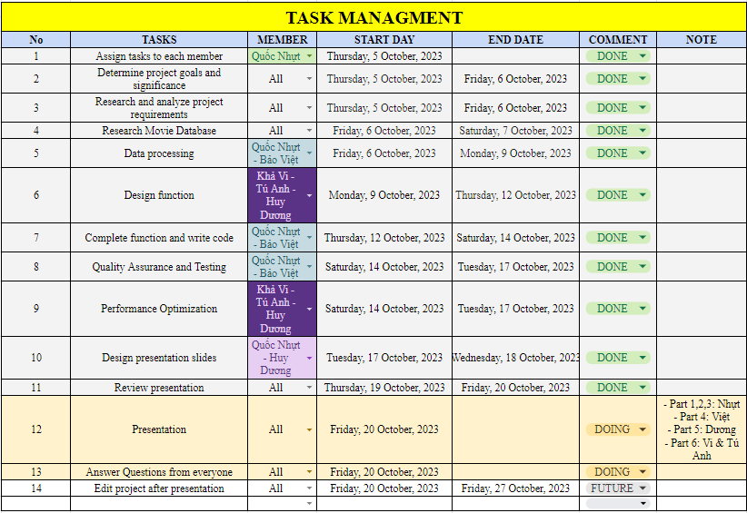
TASKS

Slide 6
Project goals and significance

Slide 7

THE GOAL OF THIS PROJECT IS TO BUILD A MOVIE SEARCH SCRIPTS BASED ON TITLES, TAGS, CHARACTERS, DIRECTORS, ETC.
THE DEMONSTRATION SHOULD SUGGEST THE TOP APPROPRIATE FILMS.

Slide 8
Research and Project requirements

Slide 9
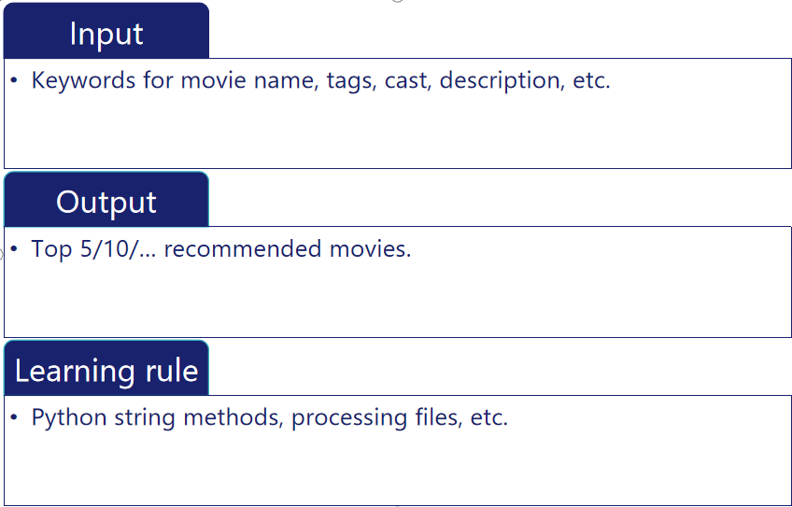

Slide 10
Research and data processing

Slide 11
Extract names from original column
ex : "[{'id': 16, 'name': 'Animation'}, {'id': 35, 'name': 'Comedy'}
to : Animation, Comedy
Applied to :
`production_companies`
- `production_countries`
- `spoken_languages`
- ‘genres’

Slide 12
`GENRES`
- `ORIGINAL_TITLE`
- `OVERVIEW`
- `PRODUCTION_COMPANIES`
- `PRODUCTION_COUNTRIES`
- `SPOKEN_LANGUAGES`
- `TITLE`
- `VOTE_AVERAGE`
- `VOTE_COUNT`
2. Keep 7 columns :

Slide 13
3. Remove duplicate rows based on ‘Original_title column

Slide 14
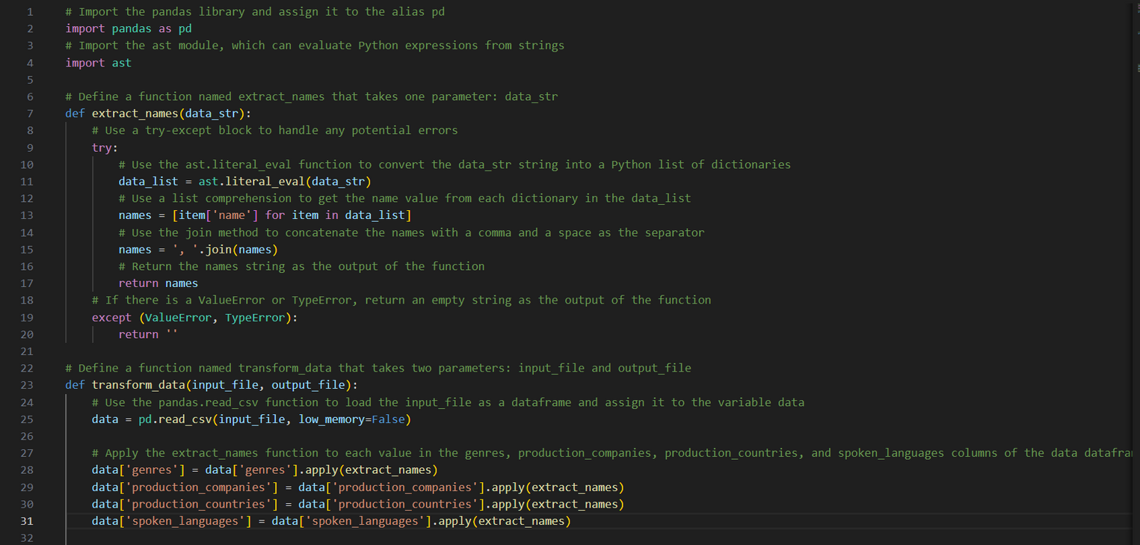
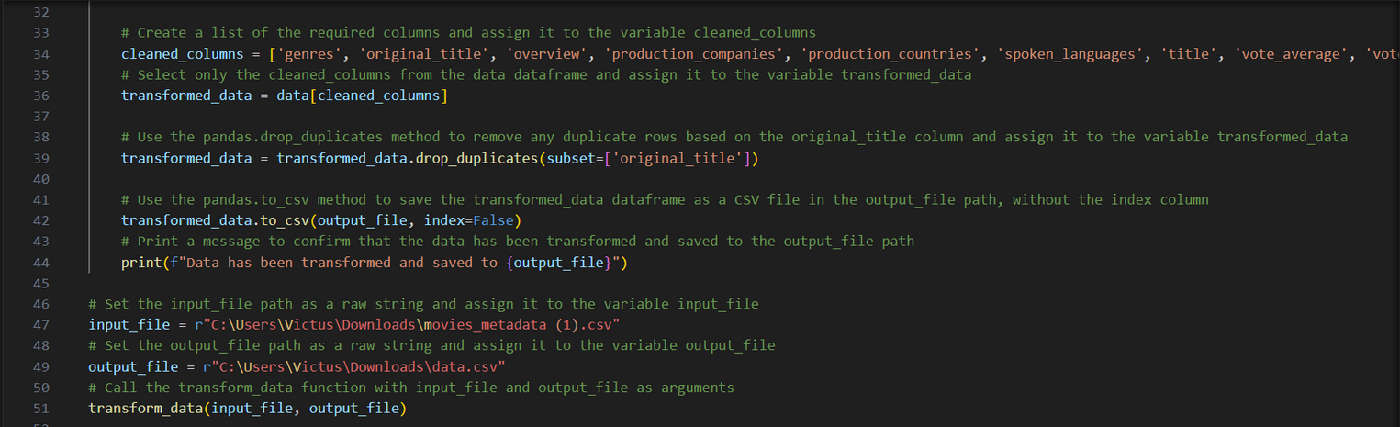
DATA_PROCESSING.PY

Slide 15
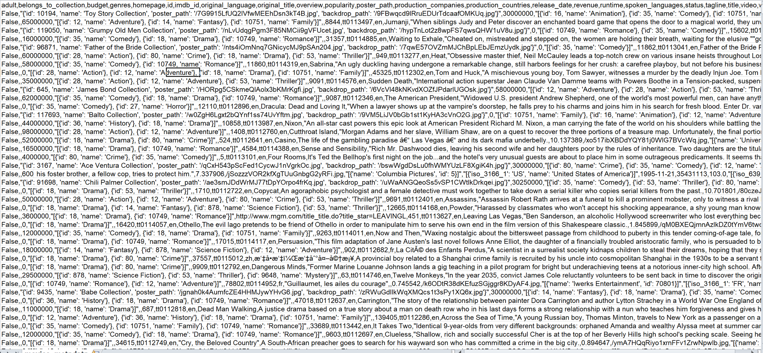
Uncleaned data

Slide 16
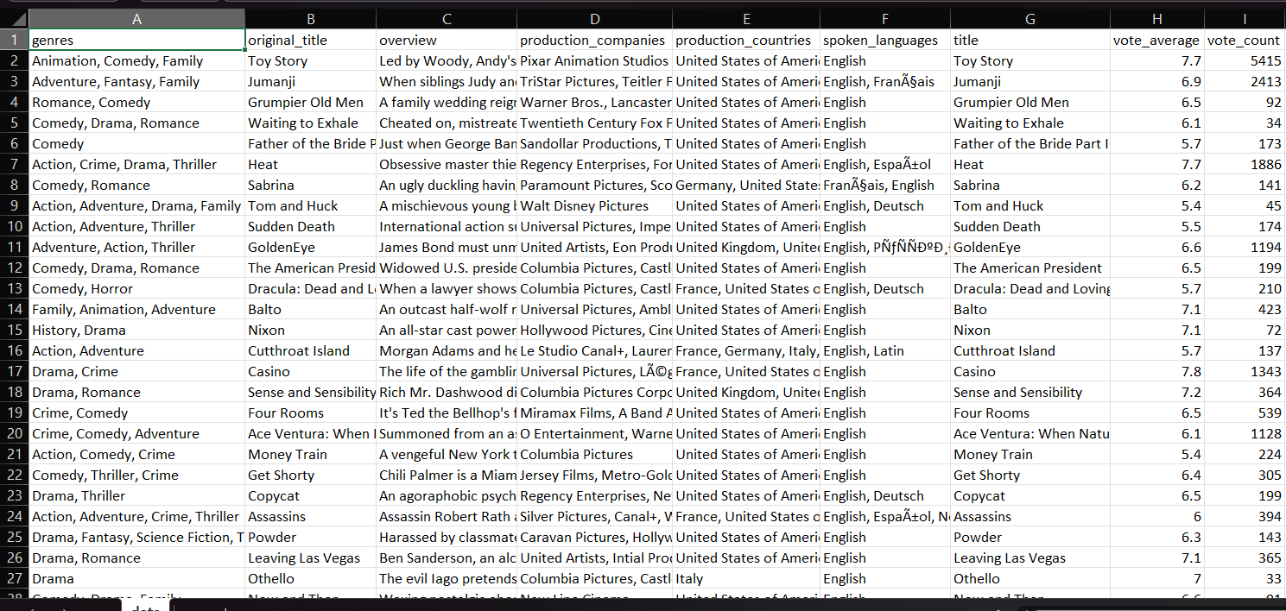
Cleaned data

Slide 17

DESIGN FUNCTION

Slide 18
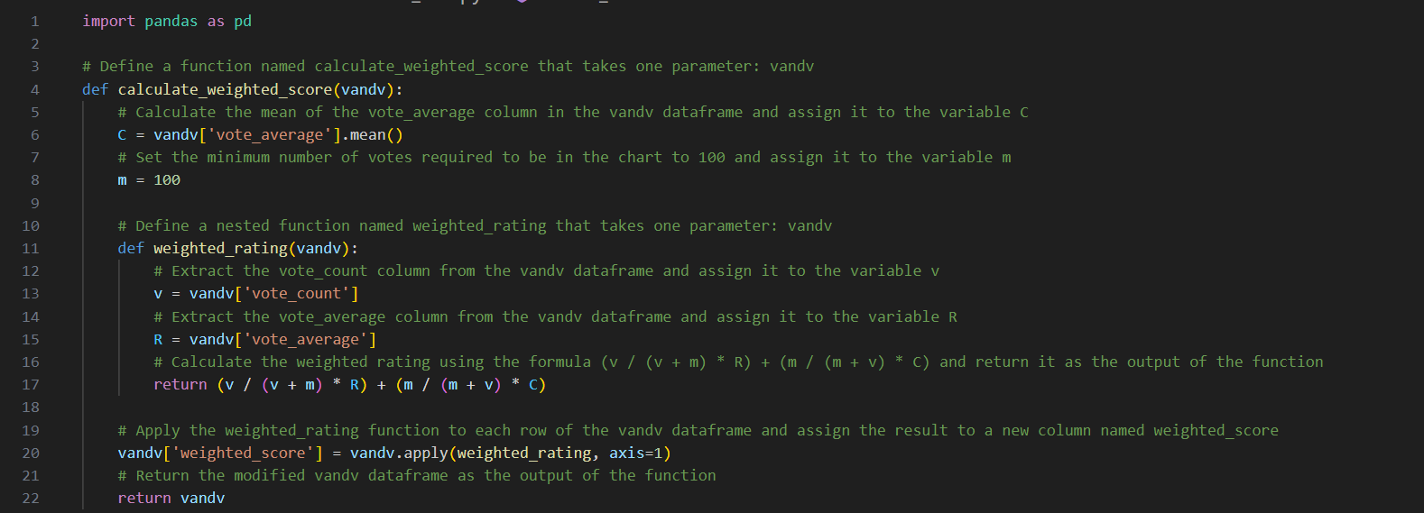
SEARCH_FILM.PY

Slide 19
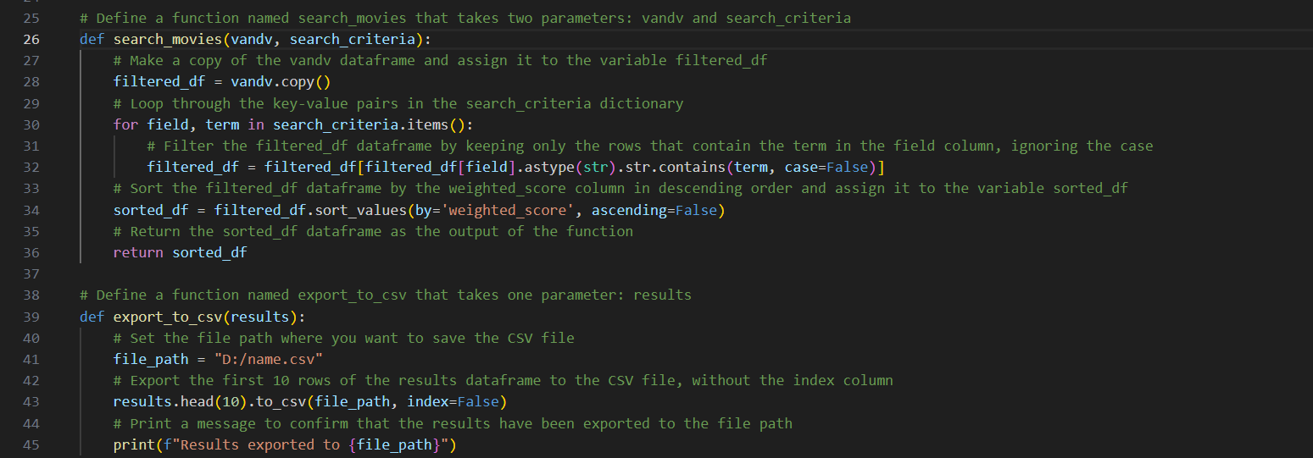

Slide 20
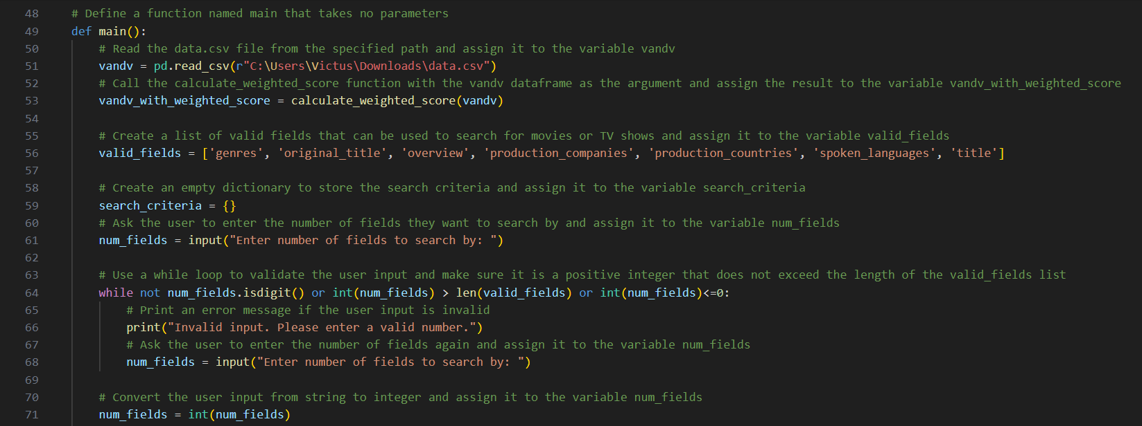

Slide 21
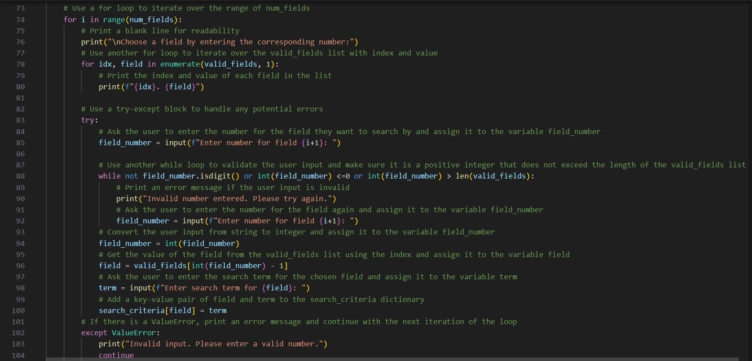
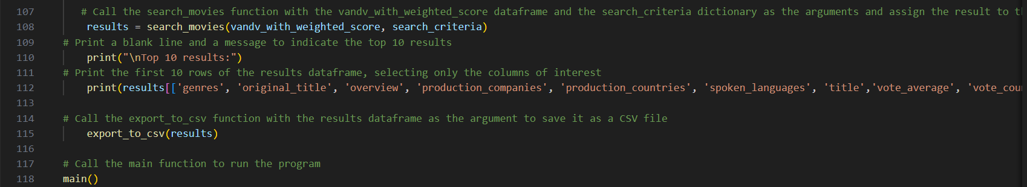

Slide 22
CODING & DEMO

Slide 23










THANK YOU !!!

